Slide 1
Business Intelligence Concepts, Tools, and Applications
Week 3: Data Visualization and Dashboard Design
Lesson 3: Performance Dashboards

Slide 2
Performance Dashboards
Learning Objectives
Define and understand the purpose of dashboards
Review examples in order to understand common characteristics and types of dashboards
See how industry leaders have successfully deployed dashboards
List attributes of metrics included in dashboards
Practice creating dashboards
Notes:
Dashboards are not a new concept. Their roots can be traced at least to the EIS of the.1980s. Today, dashboards are ubiquitous.
Currently they are used as reporting tools, largely for the purpose of evaluating a company’s performance, and are often tied with business performance methodologies like Balanced Scorecard or Six Sigma.

Slide 3

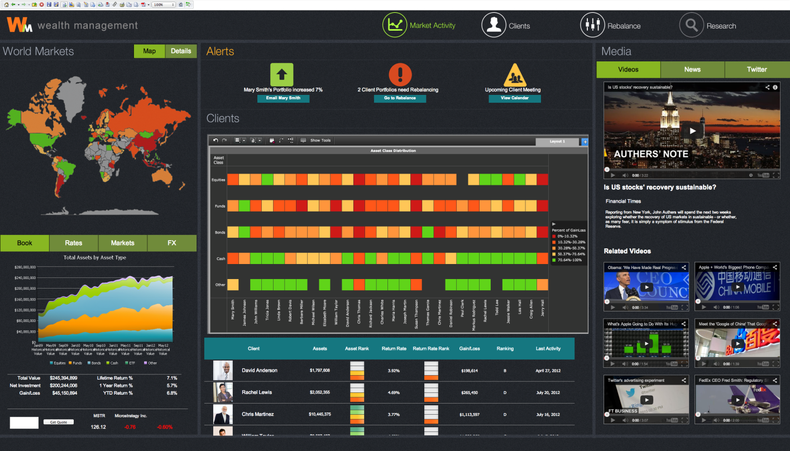
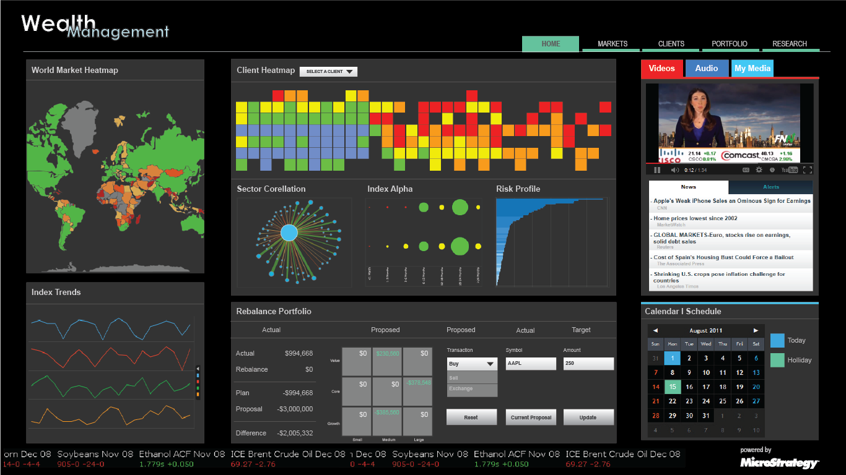
ENTERPRISE-GRADE BUSINESS INTELLIGENCE
Produce and publish trusted analytics
to elevate performance
Notes:
Performance dashboards provide visual displays of important information that is consolidated and arranged on a single screen so that information can be digested at a single glance and easily drilled in and further explored.
They are common components of most, if not all, performance management systems, performance measurement systems, BPM software suites, and BI platforms.
Dashboards pack a lot of information into a single screen, which is one reason for their popularity.
Dashboards can include many kinds of visual widgets, including charts, performance bars, sparklines, gauges, meters, stoplights, geographic maps, etc. These help to highlight, at a glance, the data and exceptions that require action. A picture tells a thousand words, and through the use of many graphical widgets, a dashboard can convey a wealth of information to decision makers in a short time.

Slide 4
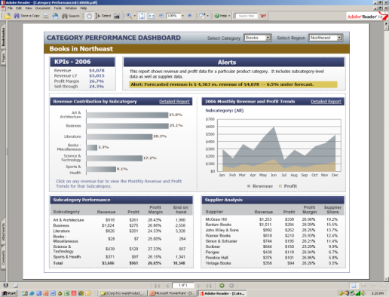
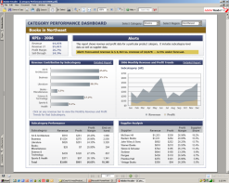
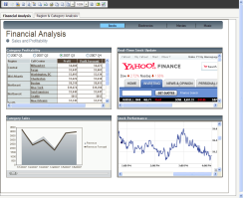
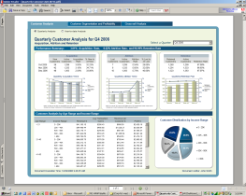


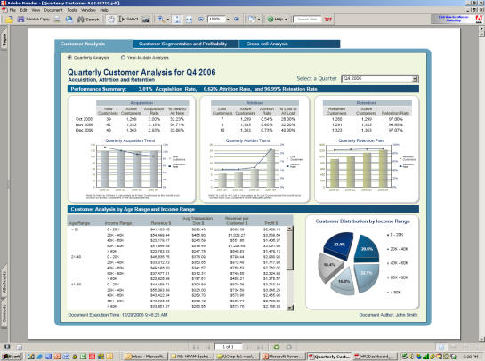
Dashboards Combine Many Reports into a Single, Easy to Understand, Dashboard Application
Dozens of Reports
Frequently Used Together
Business Dashboards
Consolidates Dozens of Reports
Multi-layout Dashboard Book
Consolidates Multiple Independent Dashboard Designs
Tab 1
Tab 2
Tab 3

Slide 5
Performance Dashboards Common Characteristics
Use of visual components to highlight data and exceptions that require action.
Transparent to the user, meaning that they require minimal training and are extremely easy to use
Combine data from a variety of systems into a single, summarized, unified view of the business
Enable drill-down or drill-through to underlying data sources or reports
Present a dynamic, real-world view with timely data
Require little coding to implement/deploy/maintain

Slide 6
Dashboard Types
Scope | Broad: Displaying information about the entire organization Specific: Focusing on a specific function, process, product, etc.
Business role | Strategic: Provides a high-level, broad, and long-term view of performance Tactical: measure the business’s progress according to related trends, in accordance with each strategic initiative Operational: Provides a focused ,near-term, and operational and business processes view of performance
Time horizon | Historical: Looking backwards to track trends Snapshot: Showing performance at a single point in time Real-time: Monitoring activity as it happens Predictive: Using past performance to predict future performance
Source; Adopted from: A Guide to Creating Dashboards People love to use, translating Delicious Data into a Beautiful Design Version 2.0. May 2015
Notes:
From: A Guide to Creating Dashboards People love to use, translating Delicious Data into a Beautiful Design Version 2.0. May 2015

Slide 7
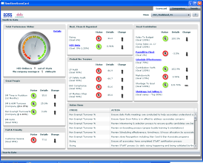
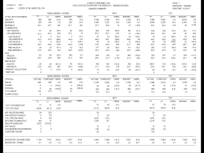
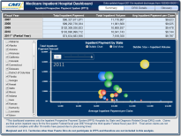
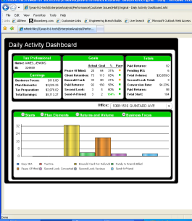
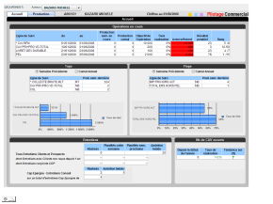
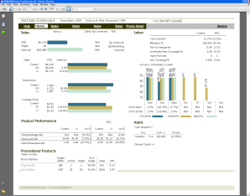
Industry Leaders Have Deployed Successful Dashboards at Unparalleled Scale
Retail
900 Store Managers
One large DashboardApp distributed daily
Content: Store Ops, KPI performance, benchmarking
3,000 Retail Managers
Dashboard delivered daily
Content: Manage inventory, improve margins
Retail
Open to public access
40+ million Medicare hospital admissions data, growing every month
Content: Detailed insights into Medicare spending per State
Government
Financial Services
15,000 Branch Managers
One large DashboardApp delivered daily
Content: Production data, Customer data, Financial
Financial Services
2,000 Bank branches employees
Dashboard delivered daily
Content: Banking and retail operations
Food & Beverage
4,000 Store Managers 30,000 DashboardApps delivered daily
Content: Store operations

Slide 8
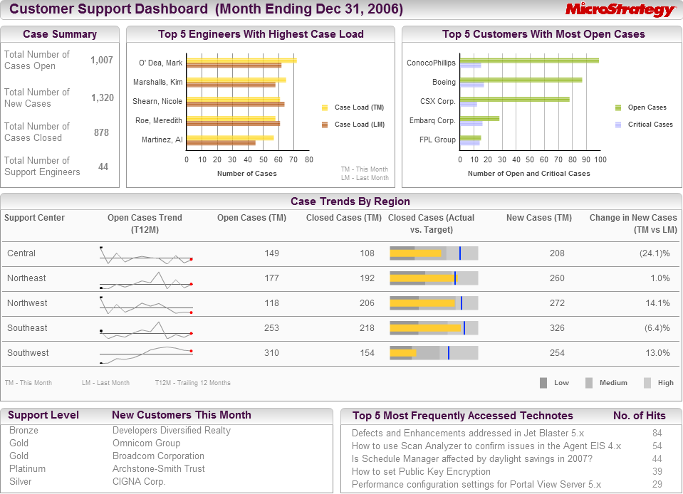
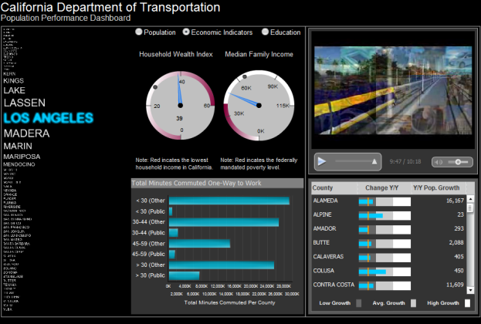
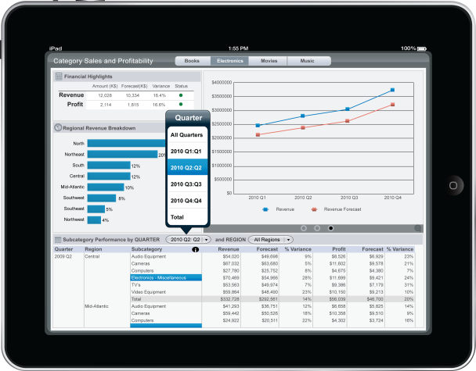
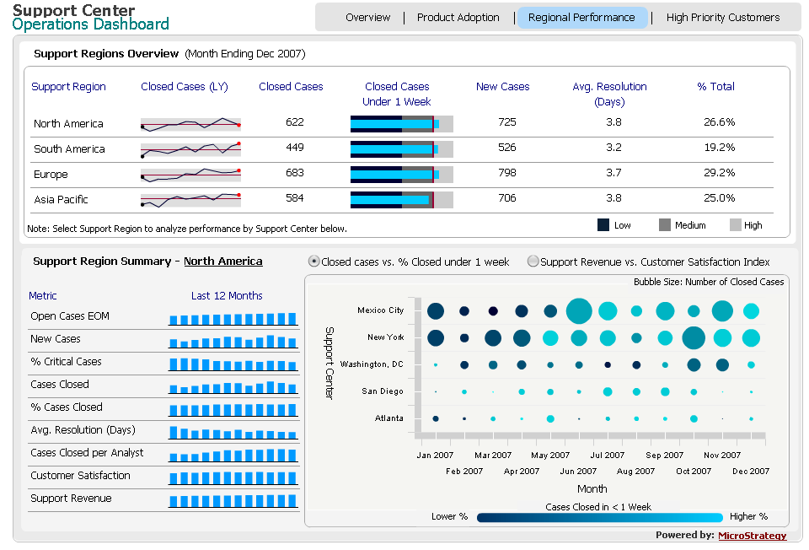
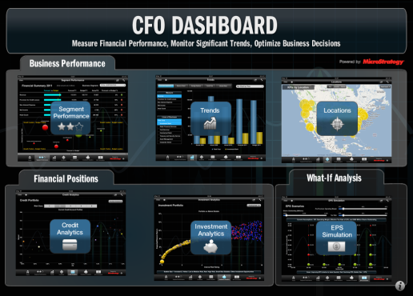
Pervasive Personalized Scorecards and Dashboards for Monitoring Performance
Dashboards
Consume Information Easily With Gauges And Dials
Integrated View of Data Across the Enterprise
Scorecards
Use Formal Scorecard Methodologies
Drill Down to View Group/ Employee Performance Scorecards
Notes:
The most basic business monitoring tool today are the scorecards and dashboards – typically generated for managers and executives who need an overall view of business performance.
Dashboards: Dashboards allow users to consume a large amount of information at a glance. Dashboards contain rich visual elements like the gauges and dials along with graphs and tables. Dashboards provide an integrated view of business performance by consolidating the data from across the enterprise
The three layers of information found in most dashboards are:
Monitoring. Graphical, abstracted data to monitor key performance metrics.
Analysis. Summarized dimensional data to analyze the root cause of problems.
Management. Detailed operational data that identify what actions to take to resolve a problem.
Scorecards: Scorecards often adhere to any of the major scorecard methodologies, like Balanced Scorecards, Activity Based Costing, 6 Sigma, or others.
Managed Metric Reports: MicroStrategy customers are also now beginning to distribute specialized reports call “managed metrics” reports. They are like dashboards, but with greater emphasis on comprehensive lists of metrics that let diverse people monitor the metrics that matter to there own contribution to the organizational goals.

Slide 9
Action items to consider before you start
Define the type of data you are working with.
Consider timeliness of this information, and how frequently the dashboard itself will be updated.
Find out about users.
Evaluate the suitability of the BI platform for the design and deployment of the dashboards
From: How to Create Compelling Business Dashboards - Complete Guide-
Notes:
From: How to Create Compelling Business Dashboards - Complete Guide- See references

Slide 10
What to include on your dashboard
Define your dashboard functionality
Don’t sacrifice substance over style
Know your users’ requirements
Validate their information requirements
Select a right metric
Select the right visual representation
From: How to Create Compelling Business Dashboards - Complete Guide-
Notes:
From: How to Create Compelling Business Dashboards - Complete Guide-- See references

Slide 11
What Makes a perfect metric?
Actionable
Metric involves a specific and repeatable action that can be linked to the observed data
Transparent
Metric involves relatively simple calculations, making it easy for users to follow them
Accessible
Metric involves data which is easy accessible, and simple to maintain
Recognizable
There is a clear, distinct, and consistent understanding of what the metric means throughout the whole dashboard
Source: Stephen Few, Information Dashboard Design 2013, A Guide to Creating Dashboards People love to use, Juice, 2009-2010.
Notes:
Source :Stephen Few, Information Dashboard Design 2013, A Guide to Creating Dashboards People love to use, Juice, 2009-2010. - See references

Slide 12
Example of Metrics
Category | Measures | Category | Measures
Sales | Bookings Billings Pipeline (anticipated sales) Number of orders Order amounts Selling prices | Fulfilment | Number of days to ship Backlog Inventory levels
Marketing | Market share Campaign success Customer demographics | Manufacturing | Number of units manufactured Manufacturing times Number of defects
Finance | Revenues Expenses Profits | Human resources | Employee satisfaction Employee turnover Count of open positions Count of late performance reviews
Technical support | Number of support calls Resolved cases Customer satisfaction Call durations
Adopted from: Stephen Few, Information Dashboard Design 2013
Notes:
From: Stephen Few, Information Dashboard Design 2013- See references

Slide 13
Ensure Metrics are Comparable
Time comparison
Allows for representing trends in data, and making comparisons against points in the past, or even against future forecasts.
Cross comparison
Allows for analyzing certain variables in relation to one another, to see if there is any correlation between them.
Goal comparison
Allows for charting progress against predetermined goals and targets.
Adopted from Stephen Few, Information Dashboard Design 2013
Notes:
From Stephen Few, Information Dashboard Design 2013- See references

Slide 14
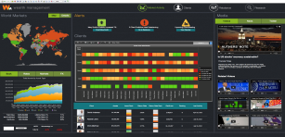

The Five Keys to Successful Information-Driven Applications
2. Actionable and Built Around A User Workflow
Guided Workflows and advanced visualizations
100% Interactive
Transact within application
1. Information Rich and Self Contained
Very high Information Density
Minimal trips back to server
Multiple sources – structured and unstructured
3. Mass Personalized Distribution
Auto role driven customization through any media
High volume scalability
In-memory performance
4. Real-time Insight
Act in real-time
Event driven triggers
Fine tune strategy with feedback
5. Mobile Optimized
Native Mobile Interfaces
Build once, Deploy many times
Full use of all mobile sensors
Notes:
Operational Dashboards add the best characteristics of traditional reports with detailed information with traditional dashboards that provide embedded interactivity and hundreds of different views of data
Operational dashboards combine all of the reports into a single, easy to understand dashboard application
Multiple dashboards in a single dashboard book
Combines all of the information for a specific decision, or job, or role that can be used by the correct operational worker

Slide 15
Action Items for Selecting Metrics
Start by defining what your dashboard is trying to achieve.
Avoid concentrating on style over substance.
Gain an insight into what it is that your users want.
Assess what information is really necessary. Know the components of a ‘perfect metric’.
Make sure that these metrics allow for meaningful comparison.
Adopted from A Guide to Creating Dashboards People love to use, Juice, 2009-2010.
Notes:
From A Guide to Creating Dashboards People love to use, Juice, 2009-2010 See references

